Slide 1


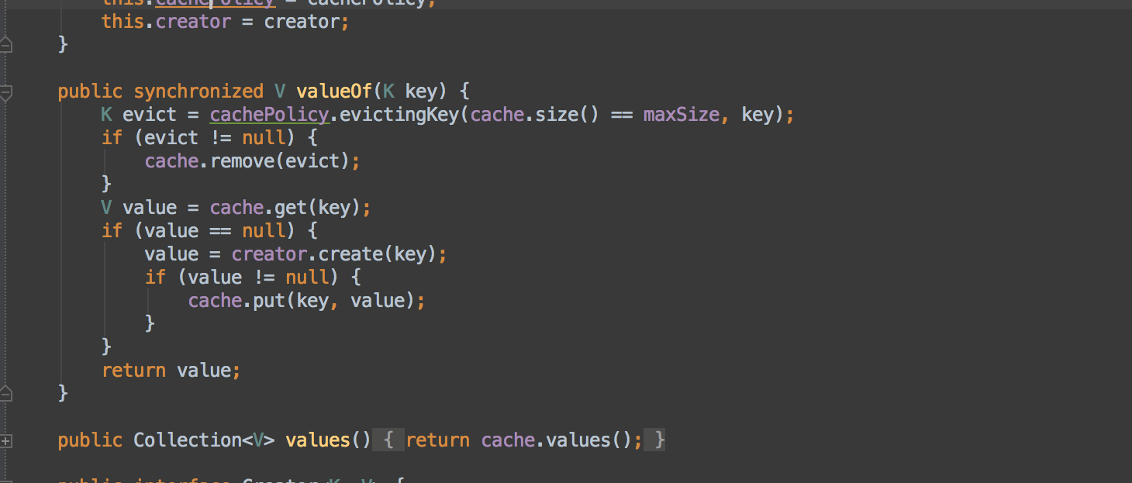


Functional Programming
Stream API
Advanced
Java
SoftUni Team
Technical Trainers
Software University
http://softuni.bg

Slide 2


Table of Contents
Stream API
Simple Operations
The Collector Class
Harder Operations

Slide 3
Stream API : Simple Operations
filter()
Returns a Stream of elements that match the given predicate
map()
Iterates through the elements and applies given function on each of them
On non-primitive types
On primitive types
sorted()
Returns a Stream sorted according to the given Comparator

Slide 4
Stream API : Simple Operations (2)
peek()
Returns a Stream of elements that match the given predicate
distinct()
Returns a Stream consisting of the distinct elements
limit()
Returns a Stream truncated to size equal to the given length
skip()
Returns a Stream consisting of the remaining elements after discarding the first N elements (N is given as parameter)

Slide 5

The Collector Class

Slide 6
Collectors : Built in Operations
toList()
Returns a List with collected elements
toSet()
Returns a Set with collected elements
toCollection()
Returns a Collection with collected elements by the given Collection type
summarizingInt()
Applies a function on each element in the Stream and returns
summary statistics (e.g. Max Element, Min Element, Sum … )

Slide 7

Stream API : Harder Operations

Slide 8
Collectors.partitioningBy()
Partitioning a collection into two groups. First group conforms
the given boolean condition and the second does not.
Map<Boolean, List<Employee>> partitions = employees
.stream()
.collect(Collectors
.partitioningBy(employee ->
employee.getSalary > 1500));

Slide 9
Collectors.groupingBy()
Transforms a collection into groups. Each group has a key -
the result of the given lambda parameter.
Map<Double, List<Employee>> partitions = employees
.stream()
.collect(Collectors
.groupingBy(employee ->
employee.getSalary());

Slide 10
Collectors.toMap()
Transforms a collection to map
Map<String, Integer> employees = people
.stream()
.collect(Collectors
.toMap(p -> p.getName(), p -> p.getAge()));

Slide 11

groupingBy() and toMap()
Exercises in class

Slide 12
flatMap()
Collapses multiple collections to a single collection
Here we’ve combined all of the integers in the list of lists to a single list of integers.
List<Integer> integers = nestedLists
.stream()
.flatMap(list -> list.stream()) .collect(Collectors.toList());

Slide 13
reduce()
Performs a reduction on the elements of the Stream
Equivalent to :
List<Integer> list = new ArrayList<>(Arrays.asList(1,2,3));
int reduced = list.stream().reduce((e1, e2) -> e1 + e2).get(); // 6
Integer reduced = 0;
for(Integer element : integers) {
reduced = accumulator.apply(element);
}
return reduced;

Slide 14








Stream API
https://softuni.bg/courses/java-fundamentals

Slide 15

License
This course (slides, examples, demos, videos, homework, etc.) is licensed under the "Creative Commons Attribution-NonCommercial-ShareAlike 4.0 International" license
Attribution: this work may contain portions from
"Fundamentals of Computer Programming with C#" book by Svetlin Nakov & Co. under CC-BY-SA license
"OOP" course by Telerik Academy under CC-BY-NC-SA license

Slide 16






Free Trainings @ Software University
Software University Foundation – softuni.org
Software University – High-Quality Education, Profession and Job for Software Developers
softuni.bg
Software University @ Facebook
facebook.com/SoftwareUniversity
Software University @ YouTube
youtube.com/SoftwareUniversity
Software University Forums – forum.softuni.bg

